Slide 1
CSC 322: Computer Organization Lab
Logic Design
Dr. Haidar M. Harmanani

Slide 2
Part I: Bits and Bytes

Slide 3
Encoding Byte Values
Byte = 8 bits
Binary 00000000₂ to 11111111₂
Decimal: 0₁₀ to 255₁₀
Hexadecimal 00₁₆ to FF₁₆
Base 16 number representation
Use characters ‘0’ to ‘9’ and ‘A’ to ‘F’
Write FA1D37B₁₆ in C as
0xFA1D37B
0xfa1d37b
Decimal
Hex
Binary
0
0
0000
1
1
0001
2
2
0010
3
3
0011
4
4
0100
5
5
0101
6
6
0110
7
7
0111
8
8
1000
9
9
1001
A
10
1010
B
11
1011
15213: 0011 1011 0110 1101
C
12
1100
D
13
1101
E
14
1110
3
B
6
D
F
15
1111

Slide 4
Example Data Representations
C Data Type | Typical 32-bit | Typical 64-bit | x86-64
char | 1 | 1 | 1
short | 2 | 2 | 2
int | 4 | 4 | 4
long | 4 | 8 | 8
float | 4 | 4 | 4
double | 8 | 8 | 8

Slide 5
General Boolean Algebras
Operate on Bit Vectors
Operations applied bitwise
01101001
& 01010101
01000001
01101001
| 01010101
01111101
01101001
^ 01010101
00111100
~ 01010101
10101010
01000001
01111101
00111100
10101010

Slide 6
Bit-Level Operations in C
Operations &, |, ~, ^ Available in C
Apply to any “integral” data type
long, int, short, char, unsigned
View arguments as bit vectors
Arguments applied bit-wise
Examples (Char data type)
~0x41 → 0xBE
~010000012 → 101111102
~0x00 → 0xFF
~000000002 → 111111112
0x69 & 0x55 → 0x41
011010012 & 010101012 → 010000012
0x69 | 0x55 → 0x7D
011010012 | 010101012 → 011111012
Decimal
Hex
Binary
0
0
0000
1
1
0001
2
2
0010
3
3
0011
4
4
0100
5
5
0101
6
6
0110
7
7
0111
8
8
1000
9
9
1001
A
10
1010
B
11
1011
C
12
1100
D
13
1101
E
14
1110
F
15
1111

Slide 7
Bit-Level Operations in C
Decimal
Hex
Binary
0
0
0000
1
1
0001
Operations &, |, ~, ^ Available in C
Apply to any “integral” data type
long, int, short, char, unsigned
View arguments as bit vectors
Arguments applied bit-wise
Examples (Char data type)
~0x41 → 0xBE
~0100 00012 → 1011 11102
~0x00 → 0xFF
~0000 00002 → 1111 11112
0x69 & 0x55 → 0x41
0110 10012 & 0101 01012 → 0100 00012
0x69 | 0x55 → 0x7D
0110 10012 | 0101 01012 → 0111 11012
2
2
0010
3
3
0011
4
4
0100
5
5
0101
6
6
0110
7
7
0111
8
8
1000
9
9
1001
A
10
1010
B
11
1011
C
12
1100
D
13
1101
E
14
1110
F
15
1111

Slide 8
Shift Operations
Left Shift: x << y
Shift bit-vector x left y positions
Throw away extra bits on left
Fill with 0’s on right
Right Shift: x >> y
Shift bit-vector x right y positions
Throw away extra bits on right
Logical shift
Fill with 0’s on left
Arithmetic shift
Replicate most significant bit on left
Undefined Behavior
Shift amount < 0 or ≥ word size
Argument x
01100010
<< 3
00010000
00010000
00010000
Log. >> 2
00011000
00011000
00011000
Arith. >> 2
00011000
00011000
00011000
Argument x
10100010
<< 3
00010000
00010000
00010000
Log. >> 2
00101000
00101000
00101000
Arith. >> 2
11101000
11101000
11101000

Slide 9
Encoding Integers
short int x = 15213;
short int y = -15213;
C short 2 bytes long
Sign Bit
For 2’s complement, most significant bit indicates sign
0 for nonnegative
1 for negative

Slide 10
Two-complement: Simple Example
-16 | 8 | 4 | 2 | 1
0 | 1 | 0 | 1 | 0
10 =
8+2 = 10
-16 | 8 | 4 | 2 | 1
1 | 0 | 1 | 1 | 0
-10 =
-16+4+2 = -10

Slide 11
Numeric Ranges
Unsigned Values
UMin = 0
000…0
UMax = 2^{w} – 1
111…1
Two’s Complement Values
TMin = –2^{w–1}
100…0
TMax = 2^{w–1} – 1
011…1
Minus 1
111…1
Values for W = 16

Slide 12
Mapping Between Signed & Unsigned
Two’s Complement
Unsigned
T2U
x
T2B
B2U
ux
X
Maintain Same Bit Pattern
Unsigned
U2T
Two’s Complement
ux
U2B
B2T
x
X
Maintain Same Bit Pattern
Mappings between unsigned and two’s complement numbers: Keep bit representations and reinterpret

Slide 13
Mapping Signed ↔ Unsigned
Bits
0000
0001
0010
0011
0100
0101
0110
0111
1000
1001
1010
1011
1100
1101
1110
1111
Signed
0
1
2
3
4
5
6
7
-8
-7
-6
-5
-4
-3
-2
-1
Unsigned
0
1
2
3
4
5
6
7
8
9
10
11
12
13
14
15
T2U
U2T

Slide 14
Mapping Signed ↔ Unsigned
Bits
0000
0001
0010
0011
0100
0101
0110
0111
1000
1001
1010
1011
1100
1101
1110
1111
Signed
0
1
2
3
4
5
6
7
-8
-7
-6
-5
-4
-3
-2
-1
Unsigned
0
1
2
3
4
5
6
7
8
9
10
11
12
13
14
15
=
+/- 16

Slide 15
Relation between Signed & Unsigned
Two’s Complement
Unsigned
T2U
x
T2B
B2U
ux
X
Maintain Same Bit Pattern
w–1
0
ux
+
+
+
• • •
+
+
+
x
-
+
+
• • •
+
+
+
Large negative weight
becomes
Large positive weight

Slide 16
Signed vs. Unsigned in C
Constants
By default are considered to be signed integers
Unsigned if have “U” as suffix
0U, 4294967259U
Casting
Explicit casting between signed & unsigned same as U2T and T2U
int tx, ty;
unsigned ux, uy;
tx = (int) ux;
uy = (unsigned) ty;
Implicit casting also occurs via assignments and procedure calls
tx = ux; int fun(unsigned u);
uy = ty; uy = fun(tx);

Slide 17
Unsigned vs. Signed: Easy to Make Mistakes
unsigned i;
for (i = cnt-2; i >= 0; i--)
a[i] += a[i+1];

Slide 18
Sign Extension
Task:
Given w-bit signed integer x
Convert it to w+k-bit integer with same value
Rule:
Make k copies of sign bit:
X ′ = x_{w–1} ,…, x_{w–1} , x_{w–1} , x_{w–2} ,…, x₀
w
X
• • •
k copies of MSB
• • •
X ′
• • •
• • •
k
w

Slide 19
Sign Extension: Simple Example
Positive number
Negative number
-16 | 8 | 4 | 2 | 1
0 | 1 | 0 | 1 | 0
-16 | 8 | 4 | 2 | 1
1 | 0 | 1 | 1 | 0
10 =
-10 =
-32 | 16 | 8 | 4 | 2 | 1
0 | 0 | 1 | 0 | 1 | 0
-32 | 16 | 8 | 4 | 2 | 1
1 | 1 | 0 | 1 | 1 | 0
10 =
-10 =

Slide 20
Larger Sign Extension Example
short int x = 15213;
int ix = (int) x;
short int y = -15213;
int iy = (int) y;
Decimal
Hex
Binary
x
15213
3B 6D
00111011 01101101
ix
15213
00 00 3B 6D
00000000 00000000 00111011 01101101
y
-15213
C4 93
11000100 10010011
iy
-15213
FF FF C4 93
11111111 11111111 11000100 10010011
Converting from smaller to larger integer data type
C automatically performs sign extension

Slide 21
Part II: Transistors, Switches, and Gates

Slide 22
Technology Review
CMOS “Complementary Metal Oxide Semiconductor”
Presently prevalent chip technology
14nm CMOS cross section
14nm CMOS top view

Slide 23
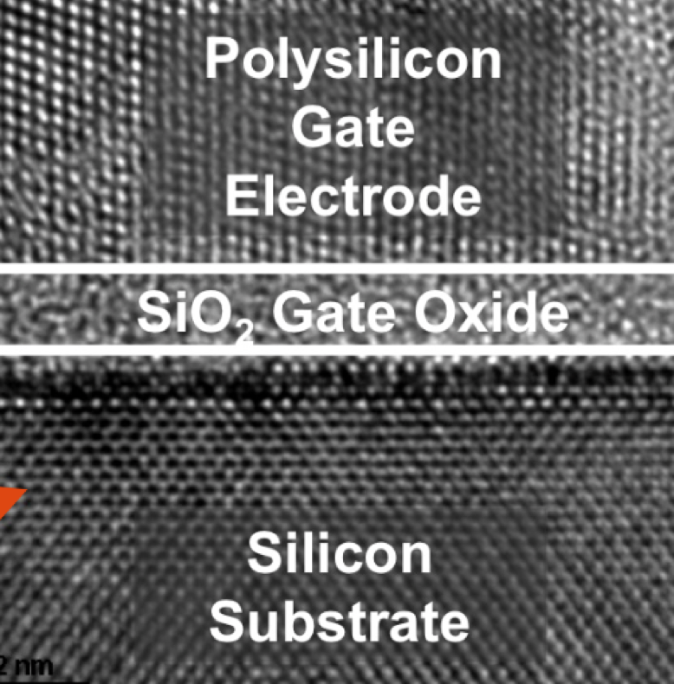
5nm Transistor
Transistor is < 100 atoms across!
Source: Intel press foils

Slide 24
Transistors for building Logic
To a computer, everything is 1’s and 0’s
In electronic circuits we represent 1’s and 0’s with voltages. E.g.
1 → 1V (5V works too, but consumes more power)
0 → 0V
Questions:
What is 0.9V?
What is 0.2V? How about 0.5?

Slide 25
Everything is bits
Each bit is 0 or 1
By encoding/interpreting sets of bits in various ways
Computers determine what to do (instructions)
… and represent and manipulate numbers, sets, strings, etc…
Why bits? Electronic Implementation
Easy to store with bistable elements
Reliably transmitted on noisy and inaccurate wires
0
1
0
1.1V
0.9V
0.2V
0.0V

Slide 26
MOS Transistor Operation
1V
0V
Transistor:
Control Terminal
C
Metal
Oxide
Silicon
A
B
Semiconductor
Model (switch):
C = 1V → switch closed (current can flow between A and B)
C = 0V → switch open (no current flows between A and B)
A
B
Yes, this is simplistic. If you cringe, you do not need this explanation. Stick with what you know already.
Notes:
C=0V: no electrons → no current can flow. Like railway with only rails but no trains.
C=1V sucks electrons up to the surface → current can flow, “carried” by the electrons.

Slide 27
CMOS Complementary Metal Oxide Semiconductor
NMOS Transistor (= Switch)
PMOS Transistor (= Switch)
Switch closed for C = 1V (“1”)
open for C = 0V
Switch closed for C = 0V (“0”)
open for C = 1V
A
A
C
C
B
B
Notes:
Ok, now we are experts.
Just one small detail: Modern processes use 2 kinds of transistors.

Slide 28
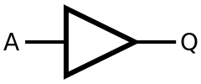
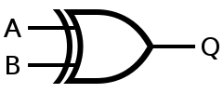
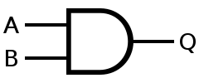
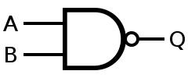
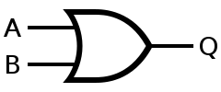
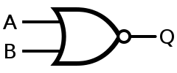
Logic Gates
Basic elements needed to implement combinational logic
Not
Xor
And
Nand
Or
Nor

Slide 29
Logic NOT (Inverter)
Notes:
Certain teenagers and politicians implement this very well.

Slide 30
NAND Gates

Slide 31
Part III: Truth Tables and Boolean algebra

Slide 32
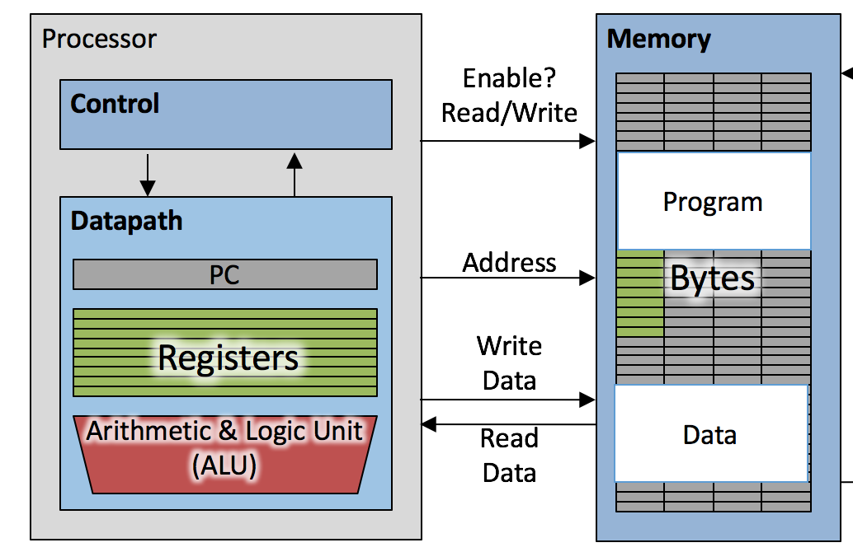
Processor Design
Combinatorial Logic
Logic, arithmetic
Hardware!
Sequential Logic
Memory
Time: do this, then that
Datapath
Implement instruction set
Control
Telling each piece what to do
Pipelining
Make it go fast!

Slide 33
The Von-Neumann Model
Memory
I/O
Processing Unit
Reg
File
ALU
Control Unit
PC
IR
Notes:
Insert von-neumann schematic here

Slide 34
Logical Design of Digital Systems
Complex Combinational and Sequential networks (up to thousands of gates)
Emphasis on combined datapath + Finite state machine designs for real time applications
Modern CAD tool usage (schematic entry, simulation, technology mapping, timing analysis, synthesis)
Logic Synthesis via Verilog
Modern implementation technologies such as Field Programmable Gate Arrays (FPGAs)

Slide 35
Truth Table
The truth value of a statement is the classification as true or false which denoted by T or F
In logic circuits, T is 1 and F is 0
The truth table lists all possible combinations of the individual statements as true or false, along with the resulting truth value of the compound statements.
Truth tables are an aide in distinguishing valid and invalid arguments.

Slide 36
Truth Table for p and q
A conjunction is the joining of two statements with the word and
The number of rows in this truth table will be 4 (2²).
Since p has 2 values, and q has 2 values)
For p and q to be true, then both statements p, q, must be true.
If either statement or if both statements are false, then the conjunction is false.
p | q | p and q
0 | 0 | 0
0 | 1 | 0
1 | 0 | 0
1 | 1 | 1

Slide 37
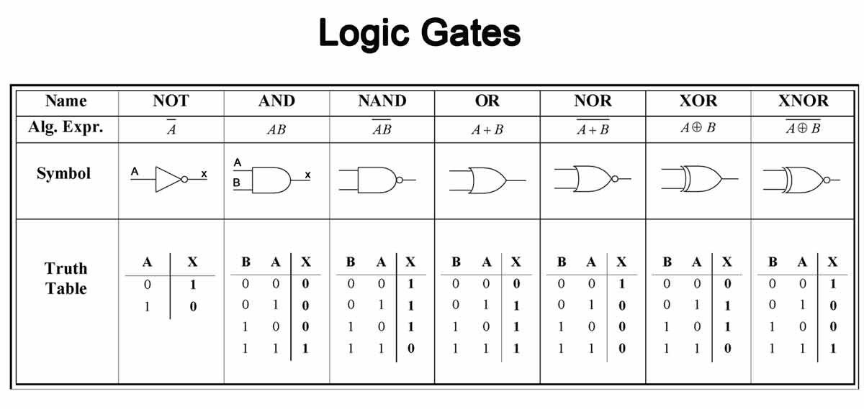
Logic Gates: Truth Tables

Slide 38
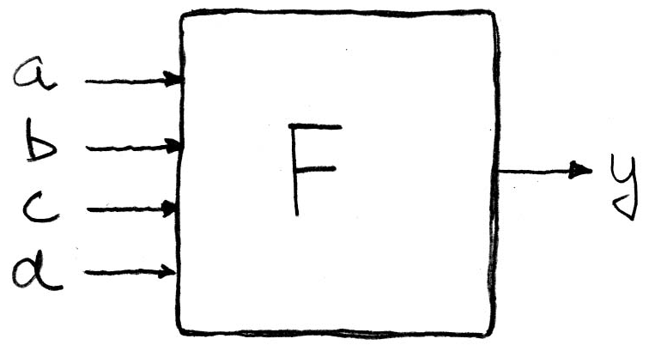
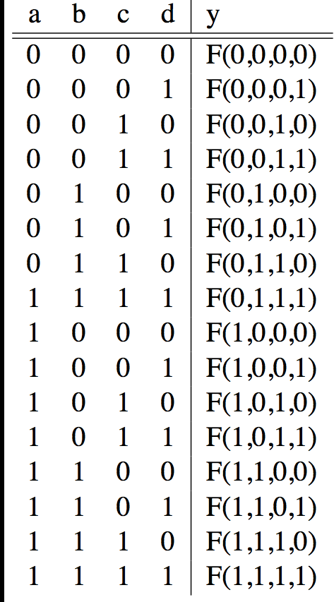
Truth Tables
0
How many Fs (4-input devices)?

Slide 39
Number of Rows
If a compound statement consists of n individual statements, each represented by a different letter, the number of rows required in the truth table is 2^{n}.

Slide 40
Boolean Algebra
George Boole, 19th Century mathematician
Early computer designers built ad hoc circuits
Began to notice common patterns in their work: NOTs, ANDs, ORs, XORs, …
Applied formal math to hardware design, logic minimization, …
The power of Boolean Algebra is that there’s a one-to-one correspondence between circuits made up of AND, OR and NOT gates and equations.

Slide 41
Boolean algebra
Boolean algebra
B = {0, 1}
+ is logical OR, • is logical AND
' is logical NOT
All algebraic axioms hold

Slide 42
Laws of Boolean Algebra
Identity: X + 0 = X Dual: X • 1 = X
Null: X + 1 = 1 Dual: X • 0 = 0
Idempotent: X + X = X Dual: X • X = X
Involution: (X')' = X
Complementarity: X + X' = 1 Dual: X • X' = 0
Commutative: X + Y = Y + X Dual: X • Y = Y • X
Associative: (X+Y)+Z=X+(Y+Z) Dual: (X•Y)•Z=X•(Y•Z)
Distributive: X•(Y+Z)=(X•Y)+(X•Z) Dual: X+(Y•Z)=(X+Y)•(X+Z)
Uniting: X•Y+X•Y'=X Dual: (X+Y)•(X+Y')=X

Slide 43
Laws of Boolean Algebra
Absorption: X+X•Y=X Dual: X•(X+Y)=X
Absorption (#2): (X+Y')•Y=X•Y Dual: (X•Y')+Y=X+Y
de Morgan's: (X+Y+...)'=X'•Y'•... Dual: (X•Y•...)'=X'+Y'+...
Duality: (X+Y+...)^{D}=X•Y•... Dual: (X•Y•...)^{D}=X+Y+…
Multiplying & factoring: (X+Y)•(X'+Z)=X•Z+X'•Y
Dual: X•Y+X'•Z=(X+Z)•(X'+Y)
Consensus: (X•Y)+(Y•Z)+(X'•Z)= X•Y+X'•Z
Dual: (X+Y)•(Y+Z)•(X'+Z)=(X+Y)•(X'+Z)

Slide 44
Proving theorems
Example 1: Prove the uniting theorem: X•Y+X•Y'=X
Distributive X•Y+X•Y' = X•(Y+Y')
Complementarity = X•(1)
Identity = X
Example 2: Prove the absorption theorem: X+X•Y=X
Identity X+X•Y = (X•1)+(X•Y)
Distributive = X•(1+Y)
Null = X•(1)
Identity = X

Slide 45
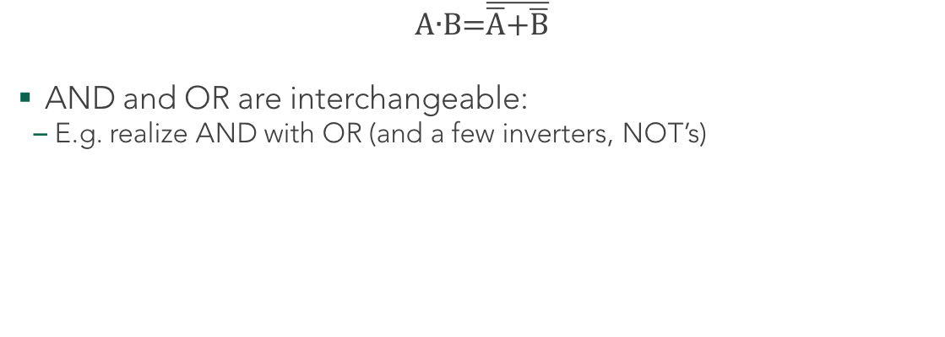
DeMorgan’s Law:
$$\text{A}\text{∙}\text{B}\text{=}\overline{\overline{\text{A}}\text{+}\overline{\text{B}}}$$
AND and OR are interchangeable:
E.g. realize AND with OR (and a few inverters, NOT’s)
Notes:
160Mflops, how fast is this? … my laptop is 100x faster!

Slide 46
Binary Addition
Carry
1
1
0
A |  | 0 | 1 | 1 | 0
B | + | 0 | 1 | 1 | 1
S = A+B |  | 1 | 1 | 0 | 1
Binary addition is just like decimal addition

Slide 47
Part IV: Algebraic Simplification

Slide 48
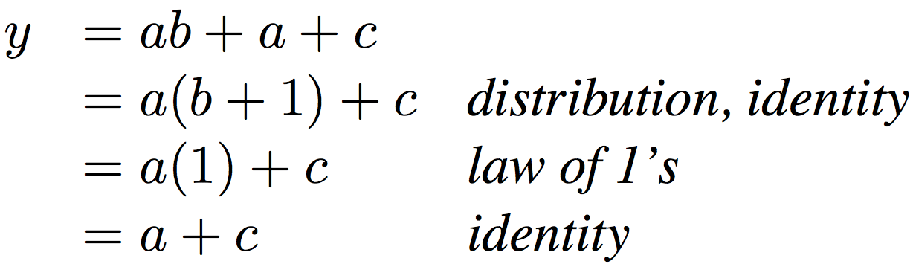
Boolean Algebraic Simplification Example
Notes:
Do on black board
First write truth table
Then minimize and check truth table
From distribution: a(b +1) + c
Froms laws of 0s and 1s: b+1 = 1
= a + c
Truth Table
a b c y
0 0 0 0
0 0 1 1
0 0 1 1

Slide 49
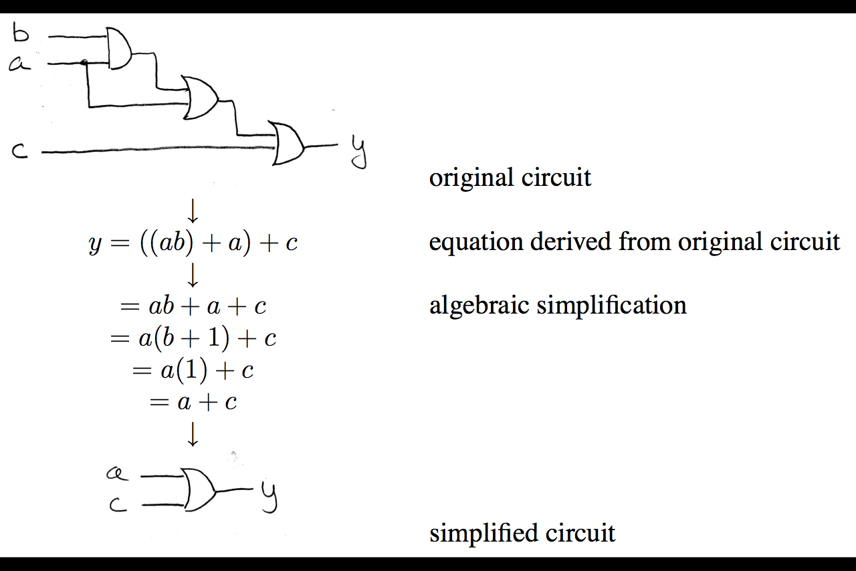
Boolean Algebraic Simplification Example
Boolean Algebra also great for circuit verification Circ X = Circ Y? use Boolean Algebra to prove!

Slide 50
Boolean Algebraic Simplification Example

Slide 51
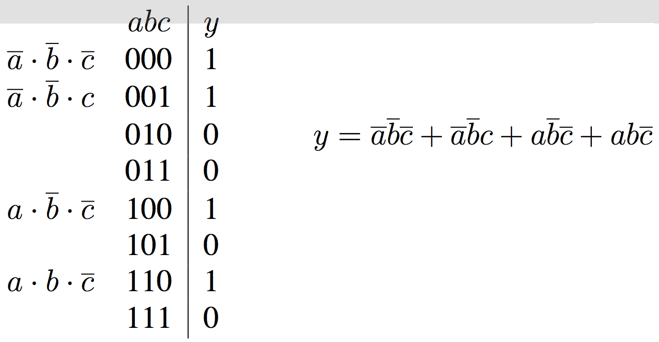
Canonical forms (1/2)
Sum-of-products
(ORs of ANDs)

Slide 52
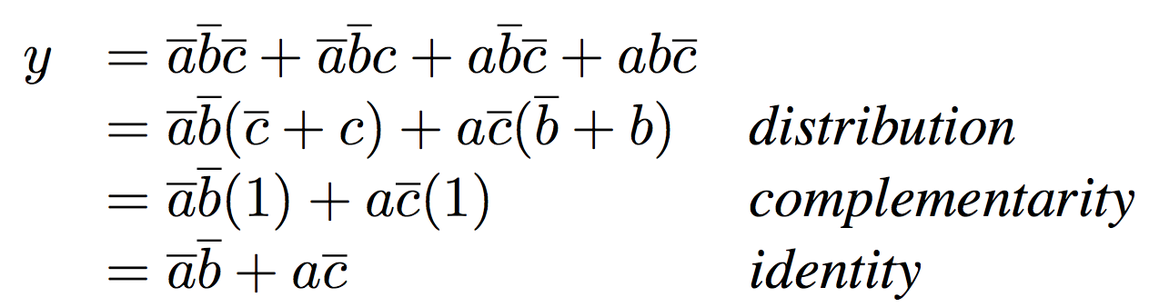
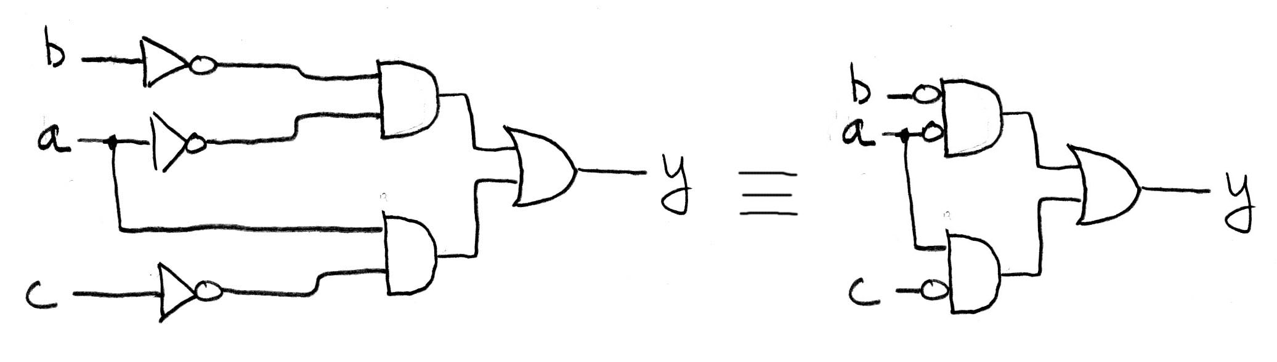
Canonical forms (2/2)

Slide 53
Boolean Minimization
Reduce a Boolean equation to fewer terms - hopefully, this will result in using less gates to implement the Boolean equation.
Pencil-Paper: Algebraic techniques, K-maps or
Automated: Many powerful algorithms exist
A B C F 0 0 0 0 0 0 1 0 0 1 0 0 0 1 1 1 1 0 0 0 1 0 1 1 1 1 0 1 1 1 1 1
F = A’BC + AB’C + ABC’ + ABC
F = BC + AC + AB
Find Boolean adjacencies to minimize equation; eliminate redundant term

Slide 54
K- maps
Graphical Aid for minimization - used to visualize Boolean adjacencies
BC
A
00
01
11
10
A B C F 0 0 0 0 0 0 1 0 0 1 0 0 0 1 1 1 1 0 0 0 1 0 1 1 1 1 0 1 1 1 1 1
0
0
0
1
0
1
0
1
1
1
BC
A
00
01
11
10
0
0
0
1
0
F = BC + AC + AB
1
0
1
1
1

